Slide 1
A MACHINE LEARNING APPROACH TO FAKE NEWS DETECTION USING BIDIRECTIONAL LSTM AND NLP
By- vineet kumar
03216401517
IT- 7th semester

Slide 2
ABSTRACT
Deep learning is a new name for an approach to artificial intelligence called neural networks, which have been going in and out of fashion for more than 70 years. Neural networks were first proposed in 1944 by Warren McCullough and Walter Pitts, two University of Chicago researchers who moved to MIT in 1952 as founding members of what’s sometimes called the first cognitive science department.
Neural nets are a means of doing machine learning, in which a computer learns to perform some task by analysing training examples. Usually, the examples have been hand-labelled in advance. An object recognition system, for instance, might be fed thousands of labelled images of cars, houses, coffee cups, and so on, and it would find visual patterns in the images that consistently correlate with particular labels.

Slide 3
ABSTRACT
Modelled loosely on the human brain, a neural net consists of thousands or even millions of simple processing nodes that are densely interconnected. Most of today’s neural nets are organized into layers of nodes, and they’re “feed-forward,” meaning that data moves through them in only one direction. An individual node might be connected to several nodes in the layer beneath it, from which it receives data, and several nodes in the layer above it, to which it sends data.
There are several approaches to handle the problem of misinformation on social media. Statistical techniques are used to identify the correlation between various features of the information, analysing the originator of the information, analysing patterns of dissemination. Machine learning algorithms are used for classification of unreliable content and analysing the accounts that share such content. Various approaches focus on developing techniques for authentication of information and on specific case studies as well.

Slide 4
INTRODUCTION
Fake news has been around as long as human civilisation, but it has been turbo-charged by digital technology and the transformation of the global media landscape. Nevertheless, defenders of fact and truth still have weapons to help uphold integrity in the social, political and economic environments.
The problem of “fake news” and misinformation appears to be a substantial problem in India. However, unlike the United States, where the focus is mostly on foreign based misinformation campaigns, India has more of a domestic misinformation problem involving major political parties and associated “cyber-army” groups. There is no specific provision in Indian law that specifically deals with fake news. However, there are several offenses in India’s Penal Code that criminalize certain forms of speech that may be relevant to fake news and may apply to online or social media content, including the crimes of sedition and promoting enmity between different groups.

Slide 5
INTRODUCTION
India is facing information wars of an unprecedented nature and scale. Indians are bombarded with fake news and divisive propaganda on a near-constant basis from a wide range of sources, from television news to global platforms like Facebook and WhatsApp.
Fake news detection problem is a binary classification problem. The proposed solution detects fake news by determining whether the information present in the article is correct on the basis of quantifying the bias of a written news article and by analysing the relationship between the news article headline and article body.

Slide 6
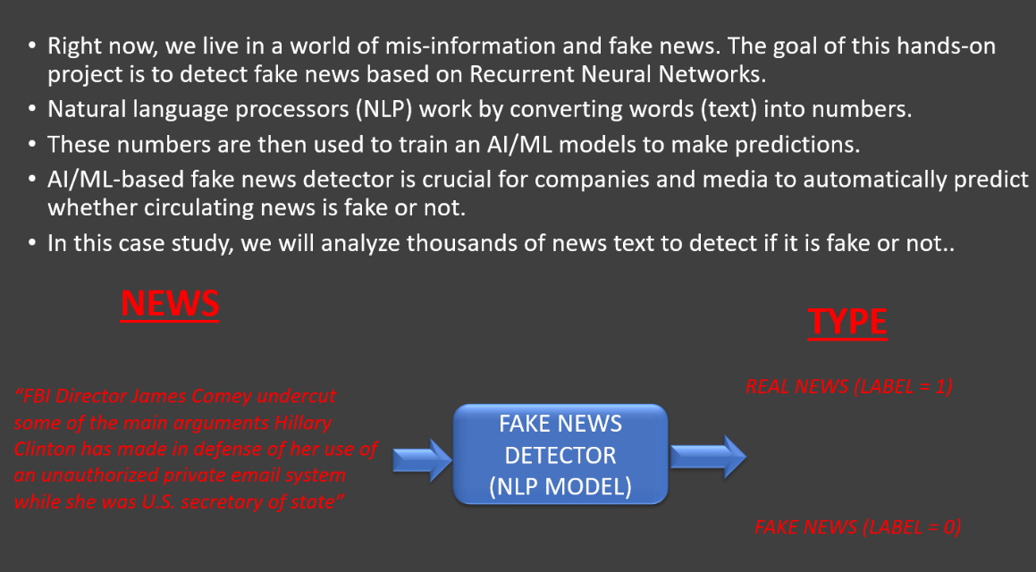
PROPOSED WORK
STEP 01:
UNDERSTAND THE PROBLEM STATMENT AND BUSINESS CASE

Slide 7
STEP 02:
IMPORT LIBRARIES AND DATASETS
Data Set- Consists of two csv files i.e. true.csv and fake.csv
https://www.kaggle.com/clmentbisaillon/fake-and-real-news-dataset
Installed a series of libraries
Plotly- to perform interactive data visualization
NLP libraries e.g.- genism, workcloud etc
nltk- NLP tool
Pandas- for data frame manipulation
NumPy- numerical analysis
Matplotlib, seaborn- data visualization
TensorFlow 2.0- Google's framework to build, trade and deploy AL(ML) models
Keras 2.0- to build our LSTM network

Slide 8
STEP 03:
PERFORM EXPLORATORY DATA ANALYSIS (FEATURE ENGINEERING)
Now, we will add new column i.e. isfake
combine two df(Data Frame) together to create one single df using pandas as pd
Then we will reset index , that goes from 0 to 44898 ( no. of samples in df_true + no. of samples in df_false )
Then we dropped date column using drop because all we are gonna leverage is title and text
Then we combined the title and the text into one massive text (original column) and will feed it to the LSTM to train the model

Slide 9
STEP 04:
PERFORM DATA CLEANING
We downloaded the stop words in English language
The NLTK corpus is a massive dump of all kinds of natural language data sets
We removed all the neutral/stop words from our data frame e.g. a, the, etc.
To actually removed the stop words by creating a preprocessor function, that took in text data ( here genism library is used for NLP ), if token(word) is not in it i.e. stop words and token length is greater than 3, then we want that word in our data frame
Then we applied preprocessor to our ‘original’ column and created new ‘clean’ column that contains no stop words
Then, we calculated the total words present in the data set
Then, we obtained the unique ones only using set function and joined it using lambda and stored that in new column ‘clean_joined’

Slide 10
STEP 05:
VISUALIZE CLEANED UP DATASET
We used seaborn(sns), countplot to see how many subjects do we have e.g. politics news, world news etc.
Then we used wordcloud (powerful visualization tool for text data) to see the most occurring words in fake and true news
Such visualization are very productive and efficient in explaining the essential features of the model to the customer
Then we used nltk tokenization on ‘clean_joined’ to tokenize and got every single unique word separately
Similarly, we found out the maximum length of words in the cleaned dataframe
Then we used plotly express to show data dynamically

Slide 11
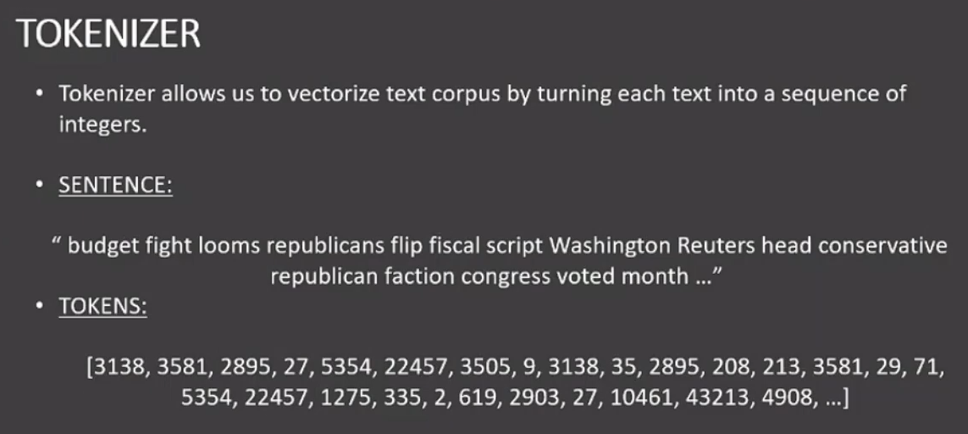
STEP 06:
PREPARE THE DATA BY PERFORMING TOKENIZATION AND PADDING
We feed this integer i.e. text data is tokenized and feed it to our AI model

Slide 12
STEP 06:
PREPARE THE DATA BY PERFORMING TOKENIZATION AND PADDING
We used scikit i.e. sklearn.model_selection and imported train_test_split to split our data in training and testing data sets i.e. 20% for testing and 80% for training
So, that the ML model is able to generalize not memorize
Then, we created a tokenizer to tokenize the words
Fit_on_texts assign vocabulary i.e. create index for the words
Text_to_sequences do the actual words by converting text into bunch of integers
We performed padding to make sure every sequence is of same length i.e. max_len
Note: what we saw in max word length in dataframe
Then padding add 0 at the end of empty datasets to complete it to the max_length

Slide 13
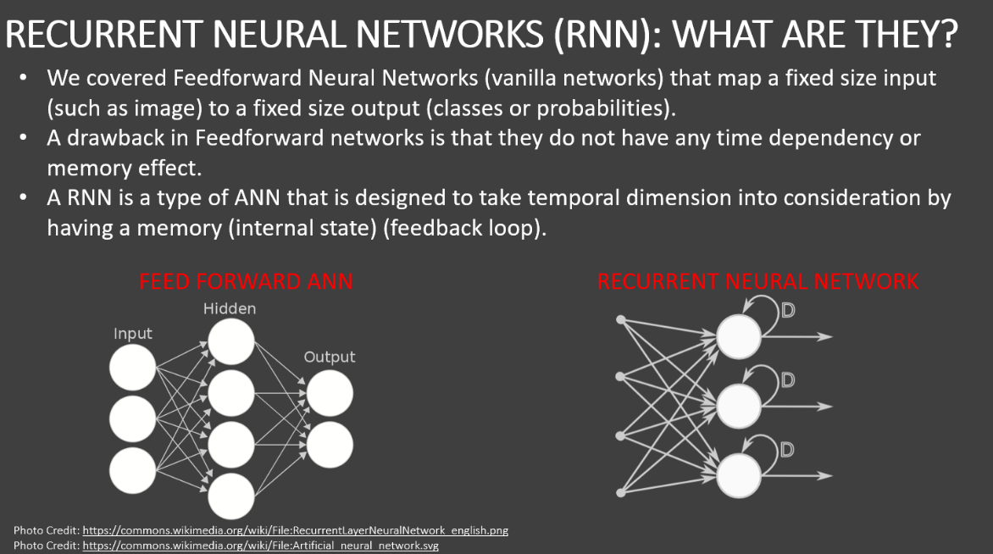
STEP 07:
UNDERSTAND THE THEORY AND INTUITION BEHIND RECURRENT NEURAL NETWORKS AND LSTM

Slide 14
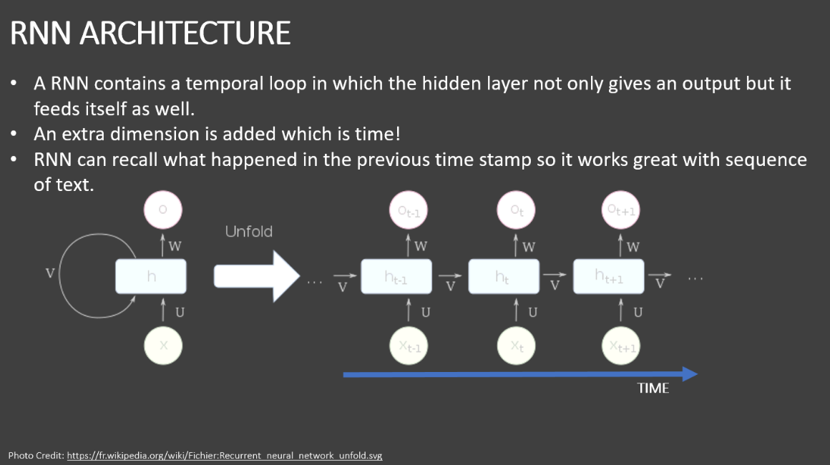

Slide 15
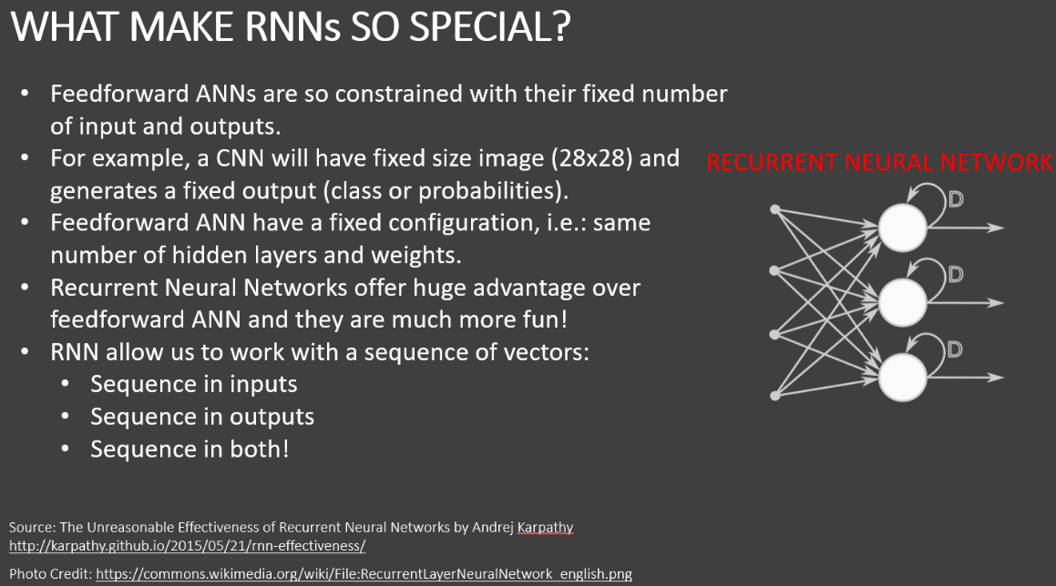

Slide 16
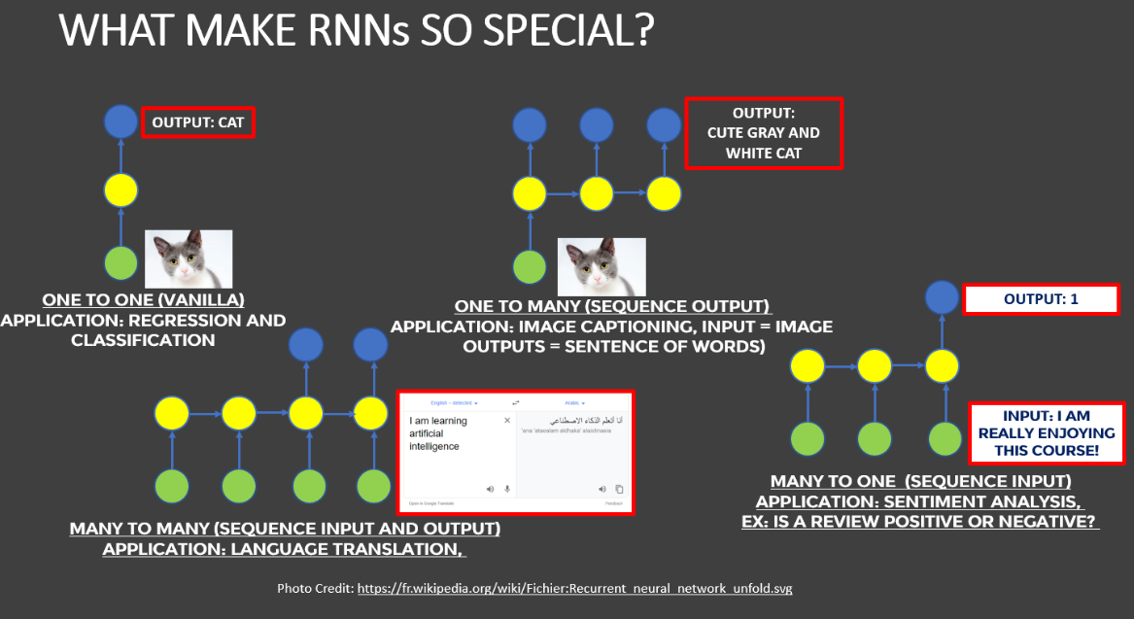

Slide 17
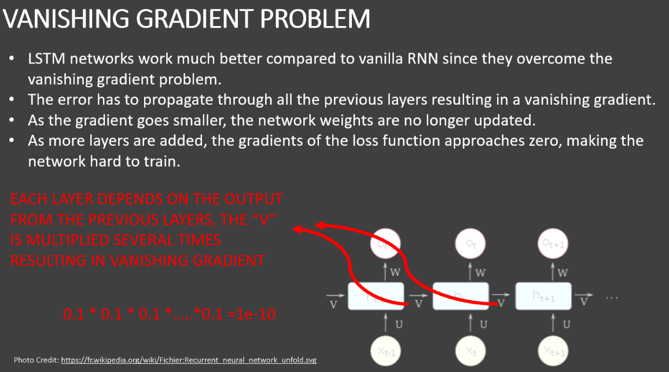

Slide 18
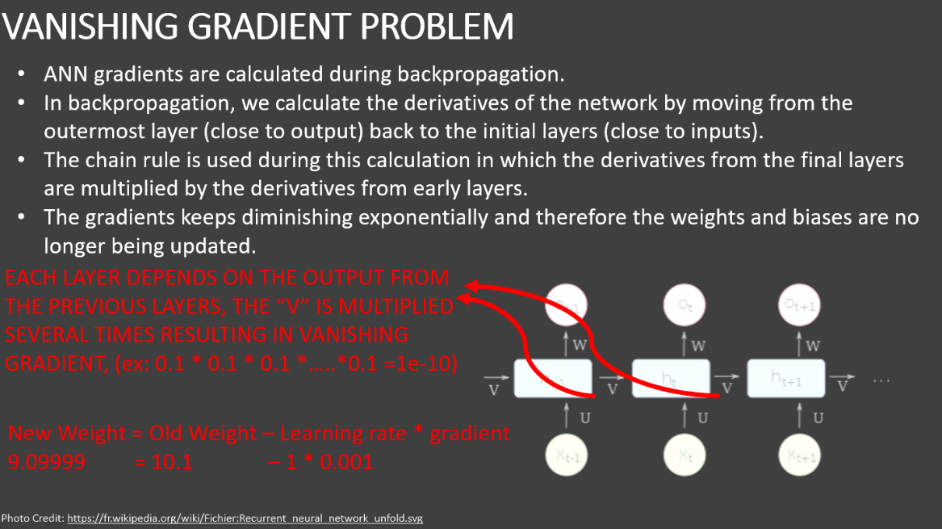

Slide 19
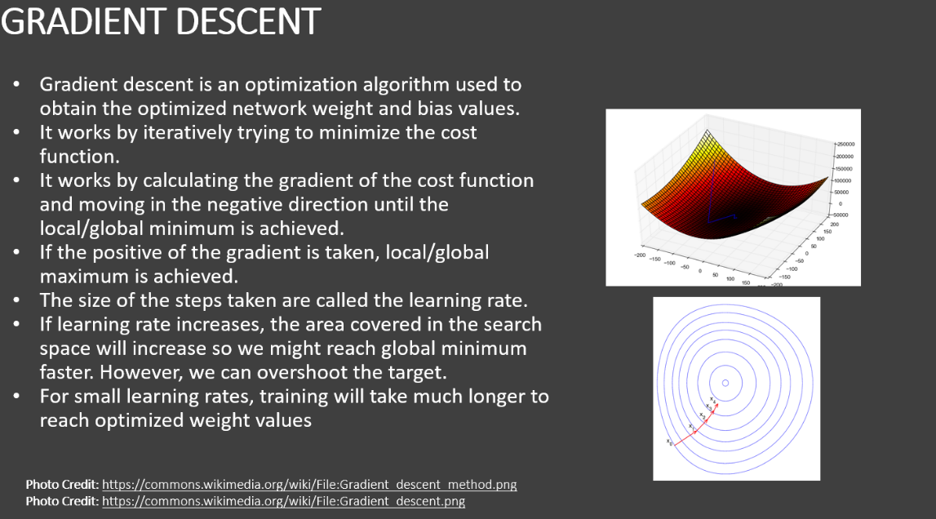

Slide 20
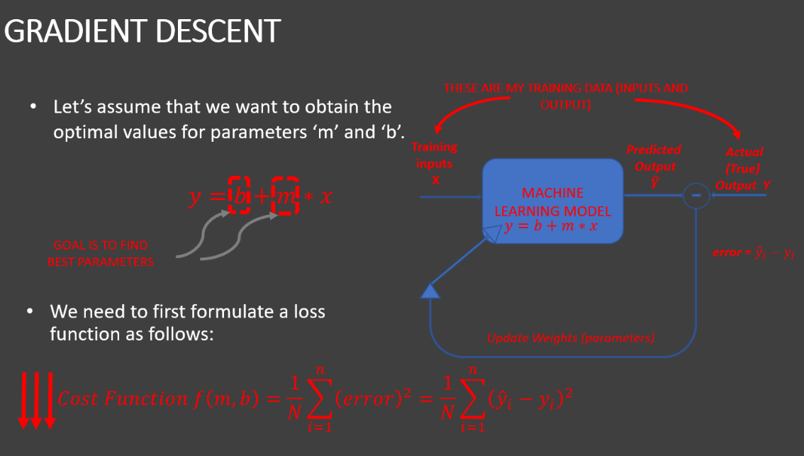

Slide 21
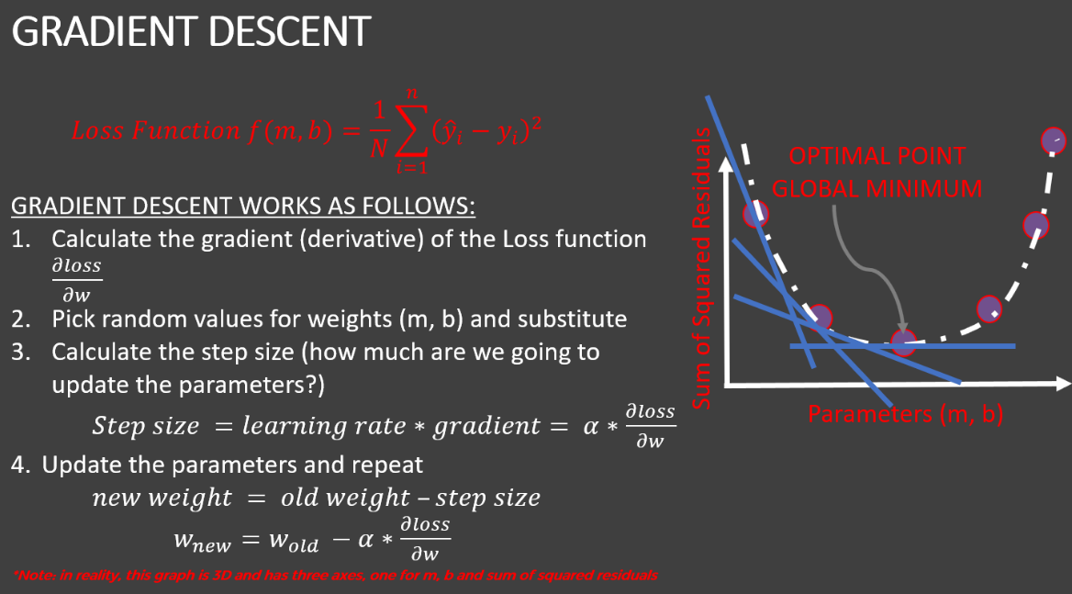

Slide 22
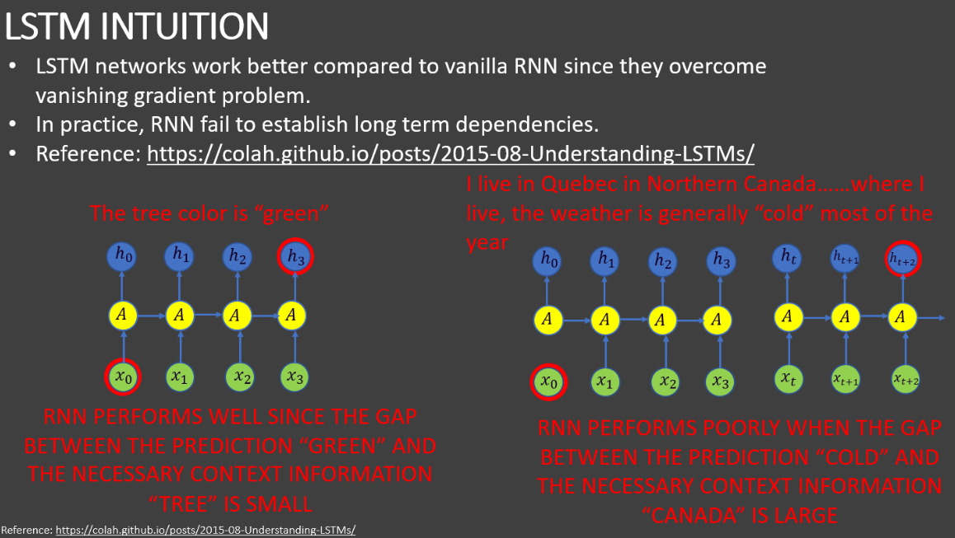
STEP 08:
UNDERSTAND THE INTUITION BEHIND LONG SHORT TERM MEMORY (LSTM) NETWORKS

Slide 23
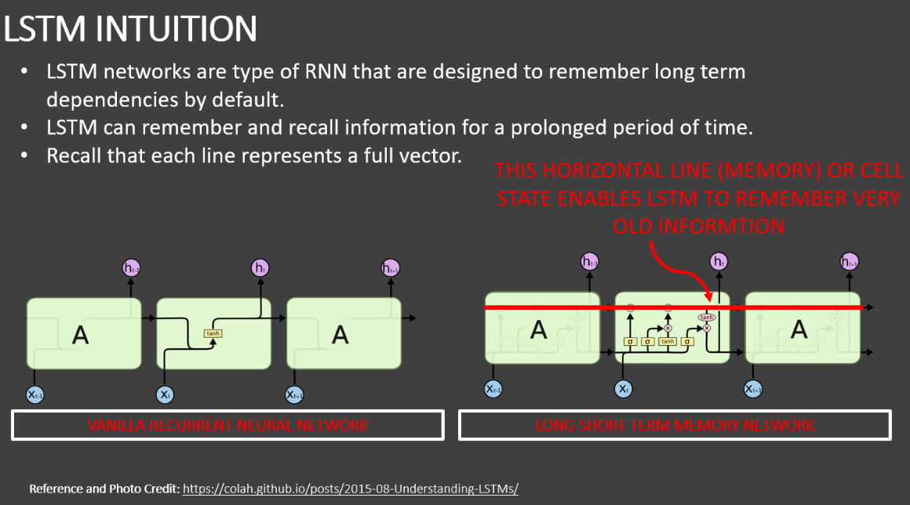

Slide 24
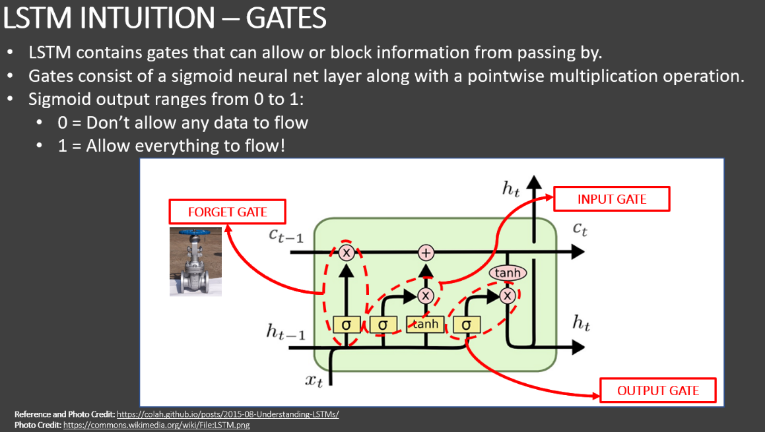

Slide 25
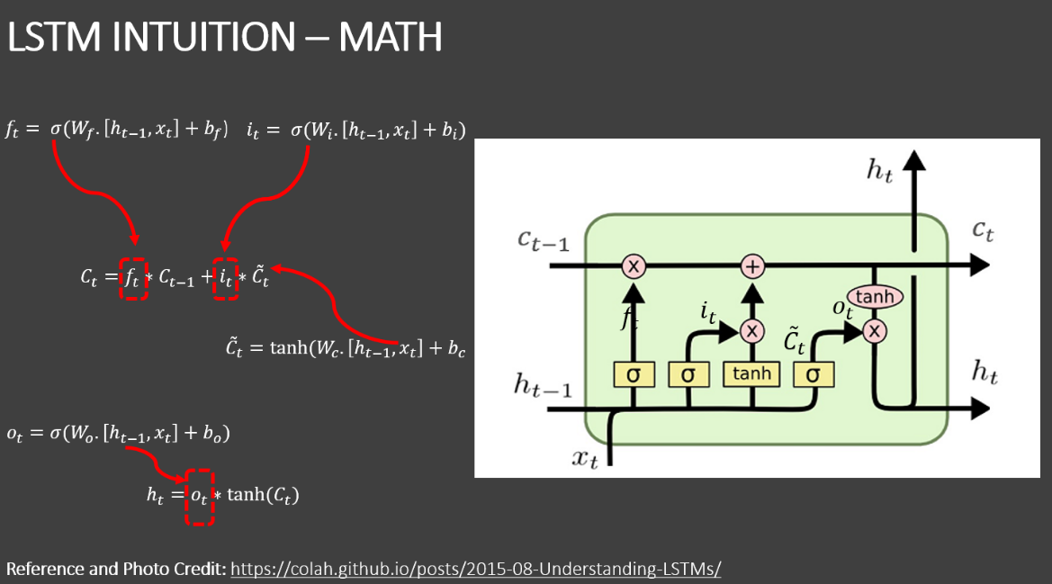

Slide 26
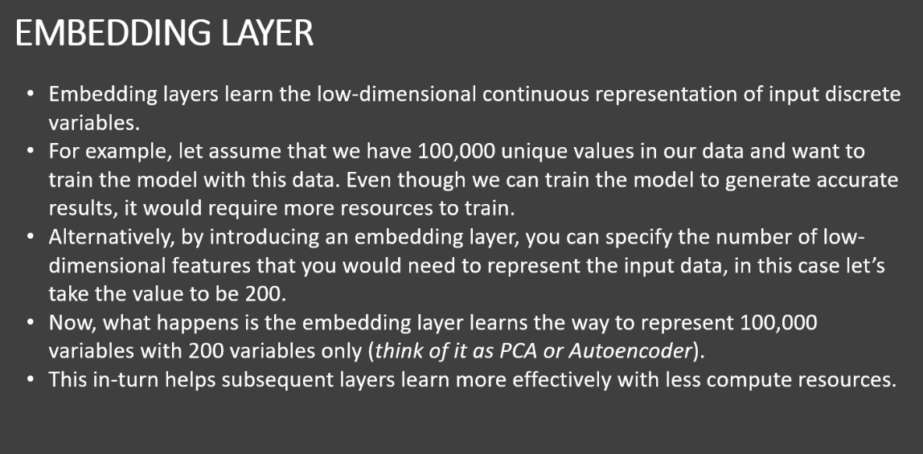
STEP 09:
BUILD AND TRAIN THE MODEL

Slide 27
By implementing embedding layer we reduce our computational power requirement
Then, we added our model i.e. model=sequential()
Then, embedding layer i.e. model.add(Embedding(total_words, output_dim = 128)), where 128 is the dimensions
Then we added Bidirectional LSTM i.e. model.add(Bidirectional(LSTM(128))), with 128 neurons
Then, we added Feed Forward Neural Network layer
Note: the output of dense_7 is 1 because we are doing binary classification
Then, we converted our training output into array for ease
Then, we performed model training where,
Padded_train was our input and y_train our output
With validation_split to10% and epochs to 2

Slide 28
STEP 10:
ASSESS TRAINED MODEL PERFORMANCE
Achieved 98% accuracy in the training data
Since we used sigmoid output function the prediction will be in probability
We set the threshold that if predictions are greater than 0.5 then its class if less than 0.5 then class 0
Using confusion matrix we found out our misclassification

Slide 29
Thank You

